Slide 1
PHASE 2 SUBMISSION
Student name: KEERTHANA.S
Register number:422323106011
Institution:Thiruvalluvar College of Engineering and Technology
Department:Electronics and Communication Engineering
Date of submission: 08.05.2025

Slide 2
PREDICTING CUSTOMER CHURN USING MACHINE LEARNING TO UNCOVER HIDDEN PATTERNS

Slide 3
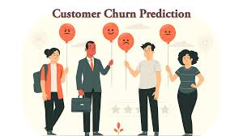
1.PROBLEM STATEMENT
High customer turnover is eroding revenue and increasing acquisition costs.
Manual churn-analysis approaches can’t scale to large ,complex data sets.
Existing methods often miss non obvious patterns leading to reactive
(non proactive) retention strategies.

Slide 4
2.OBJECTIVES OF THE PROJECT
Leverage machine learning techniques to accurately predict customer churn
Uncover hidden patterns in customer data that traditional analysis might miss
Identify key churn indicators such as usage trends, support interactions or account behaviour
Enable proactive retention strategies by predicting churn before it happens
Support business decision making through actionable data driven insights

Slide 5
3.SCOPE OF THE PROJECT
Focuses on analysing historical customer data to predict churn behaviour
Utilizes supervised machine learning models for classification tasks
Cover data processing,feature engineering,model training and evaluation
Applicable across various industries like telecom, banking,e-commerce with customer based services
Helps businesses identify at risk customers early and implement retention strategies

Slide 6
4.DATA SOURCES OF PROJECT
Customer demographics:Age,gender,location,tenure etc..
Service usage data:Call durations,Internet usage,product subscriptions etc..
Customer support interactions:Complaints,number of tickets raised,resolution time
Billing & Payment information:Payment methods,billing issues,late payments
Historical churn labels:Records of whether customers have churned in the past

Slide 7

5.HIGH LEVEL METHODOLOGY
Major steps of the project
Data collection
Data cleaning
Exploratory Data Analysis(EDA)
Feature engineering
Model building
Model evaluation
Visualization & Interpretation
Deployment

Slide 8
Data collection
Data was collected from multiple sources including internel customer databases and publicly available data sets
Collected features such as:
Customer profile details (Age,contract type,tenure)
Service usage metrics (number of calls, data consumption)
Interaction history(support tickets,complaints)
Billing and payment records

Slide 9
DATA CLEANING
Handled missing values by imputing or removing incomplete records
Removed duplicate entries to ensure data integrity
Converted categorical datas like gender and contract type using encoding techniques like label encoding or one hot encoding
Normalized numerical features to bring to a consistent scale
Identified and addressed outliers
Ensure a balanced dataset for effective training and testing

Slide 10
EXPLORATOY DATA ANALYSIS
Class imbalance: Identified a significant imbalance between churned and nonchurned customers
Corelation analysis:Discovered strong correlation between features such as tenure,contract type
Outlier detection:Appled interquartile range analysis to detect and handle outliers,ensuring data quality for modeling
Tenure didtribution and payment methods

Slide 11
FETURE ENGINEERING
Behavioral metrics:calculated features like average session duration and service usafe frequency to access customer engagement
Categorical encoding:Transformed categorical variables into numerical formats
Handling imbalanced data:Addressed class imbalance using techniques like synthetic minority over sampling techniques(SMOTE)to improve model accuracy

Slide 12
MODEL BUILDING
Algorithm selection : evaluated multiple machine learning algorithm including logistic regression,random forestand XGboost
Data spitting:divided the dataset into training and training sets
Model training:trained selected algorithms using the training datasets optimizing for accuracy ad generalization
Cross validation:implemented k-fold cross validation to ensure model robustness and prevent overfitting

Slide 13
VISUALIZATION AND INTERPRETATION
Confusion matrix: displayed the confusion matrix to access the model’s performance interms of true positives and negatives
ROC curve: plotted the receiver operating characteristic (ROC)curve to evaluate the trade off between true and false positive rate with AUC
Temporal analysis:analyzed churn trends over time to identify seasonal patterns or periods
Customer segmentation : visualized customer segments based on churn probability enabling targeted retention stragies for high risk groups

Slide 14
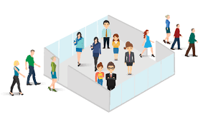
DEPLOYMENT
Model packaging : serialized the trained model using formats like pickle or joblib for deployment
API deployment:created restful APIs using frameworks such as flask or fastAPI
Cloud deployment:deployment the containerized application on cloud platforms like AWS ,asure or google cloud for scalability and accessibility
Monitoring and maintenance

Slide 15
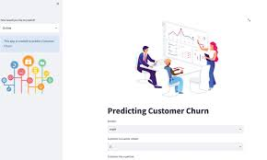
PROGRAMMING LANGUAGE
Python is the primary language for developin churn prediction models
Other key libraries are:
->pandas and numpy
->scikit learn
->matplotlib and seaborn
->XG booster
->shapg

Slide 16
Example1
import pandas as pd
from sklearn.ensemble import RandomForestClassifier
from sklearn.model_selection import train_test_split
# Load and prepare data
df = pd.read_csv("churn.csv")
df["Churn"] = df["Churn"].map({"Yes": 1, "No": 0})
# Features and target
X = df.drop("Churn", axis=1)
y = df["Churn"]
# Train model
X_train, X_test, y_train, y_test = train_test_split(X, y, test_size=0.2)
model = RandomForestClassifier().fit(X_train, y_train)
# Predict churn
predictions = model.predict(X_test)

Slide 17
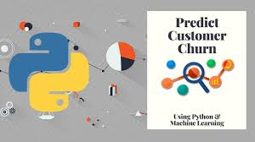
NOTEBOOK / IDE
Jupyter notebook
anaconda,
Google colab
Pycharm

Slide 18
TEAM MEMBERS AND ROLES
Keerthana.S - Problem statement, Objectives of the project
Sathya.P – Scope of the project, Data sources
Elavarasan.T - High Level Methodology ,Tools and Technologies

Slide 19
Example 2
import pandas as pd
from sklearn.linear_model import LogisticRegression
df = pd.read_csv("churn.csv")
model = LogisticRegression().fit(df[["tenure"]], df["Churn"])
prediction = model.predict([[12]]) # Predict churn for 12-month customer
print(prediction)

Slide 20
THANK YOU

